Slide 1
IMPACT OF REAL ESTATE PRICES ON HOMELESSNESS
A decadal survey of eighteen major cities in the USA (2007-2017)
UCB Data Bootcamp Project 1
Lei, Jagatha, Angela and Weiming
January 20, 2018
Notes:
Angela's video - https://drive.google.com/open?id=1uASzIhN5ePMlXOQbwlVZMikkg3UKuSnh

Slide 2

Motivation
Homelessness is the condition where a person lacks "a fixed, regular, and adequate nighttime residence" as defined by The McKinney–Vento Homeless Assistance Act.
Homelessness is visible throughout the SF Bay Area. Look around!
Does the high cost of living in the Bay Area explain the large homeless population?
In this study we assessed the impact of real estate prices on homelessness in the Bay Area and other localities across the country.
Notes:
Presentation Guidelines
You are free to structure your presentations to your liking, but students tend to have success with the following format.
Title Slide
Include the name of the Project and Group Members
Motivation & Summary Slide
Define the core message or hypothesis of your project.
Describe the questions you asked, and why you asked them
Describe whether you were able to answer these questions to your satisfaction, and briefly summarize your findings
Questions & Data
Elaborate on the questions you asked, describing what kinds of data you needed to answer them, and where you found it
Data Cleanup & Exploration
Describe the exploration and cleanup process
Discuss insights you had while exploring the data that you didn't anticipate
Discuss any problems that arose after exploring the data, and how you resolved them
Present and discuss interesting figures developed during exploration, ideally with the help of Jupyter Notebook
Data Analysis
Discuss the steps you took to analyze the data and answer each question you asked in your proposal
Present and discuss interesting figures developed during analysis, ideally with the help of Jupyter Notebook
Discussion
Discuss your findings. Did you find what you expected to find? If not, why not? What inferences or general conclusions can you draw from your analysis?
Post Mortem
Discuss any difficulties that arose, and how you dealt with them
Discuss any additional questions that came up, but which you didn't have time to answer: What would you research next, if you had two more weeks?
Questions
Open-floor Q&A with the audience

Slide 3
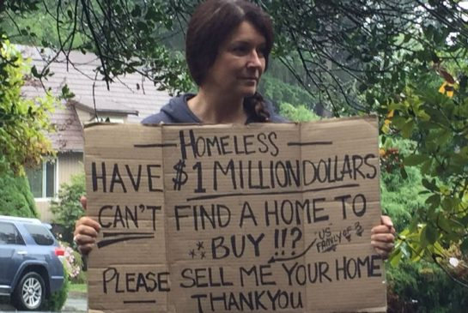

Research Questions
Is there a correlation between homelessness and real estate prices?
At what rate has homelessness changed in the past decade?
Which cities/regions of the country have the highest homeless population?
What does the homeless population demographics look like?
What other variables may affect homelessness?

Slide 4
Data Sources
Kaggle - Zillow Economics Data (1996-2017 data) -
https://www.kaggle.com/zillow/zecon/data
U.S. Department of Housing and Urban Development - HUD Exchange -
2016 AHAR: PIT (Point-In-Time) Estimates of Homelessness in the U.S.
https://www.hudexchange.info/resource/3031/pit-and-hic-data-since-2007/
CoC Homeless Populations and Subpopulations Reports-
https://www.hudexchange.info/programs/coc/coc-homeless-populations-and-subpopulations-reports/
U.S. Census Bureau State Population Totals -
https://www.census.gov/data/datasets/2017/demo/popest/state-total.html
Notes:
Zillow API
During the Initial Phase, we decided to use Zillow API for housing data.
But then we didn’t get the expected data that can go with HUD.
So we had to use the data from Kaggle for our analysis.

Slide 5
Data Cleanup & Exploration
Zillow Economics Dataset
Uploaded city_time_series and cities_croswalk file into Jupyter . Large file size loaded in chunks.
Datasets were merged and reduced to a selected number of columns of potential interest (estimated median and actual sale prices, and rental prices) and truncated to 2007-2017, based on homeless data availability.
City and state were combined into one column ‘CityState’ and set as the index.
Created a function to split the ‘Date’ column and create a ‘Year’ column.
A new dataframe was created containing 18 major cities of interest selected based on data available from the HUD homeless dataset.
The new dataframe was grouped by ‘CityState’ and ‘Year’ columns, to get an estimated median home value per city for each year, and was exported as a CSV file ‘18_zillow_selected_cities.csv’ for further analysis.
NaNs were not removed in order to visually assess which columns had the most/least gaps in data for future analysis.
Notes:
ZHVI - a smoothed seasonally adjusted measure of the median estimated home value across a given region and housing type

Slide 6
Data Cleanup & Exploration - Cont’d
HUD - The U.S. Department of Housing and Urban Development Dataset
Data set contained national estimates of homelessness by CoC Number and CoC Name and estimates of different categories of homelessness from 2007 - 2017.
Estimates of homeless veterans were included since 2011.
Hence the column headers count were not same across all worksheets.
Year information from column headers was removed and a new column ‘Year’ was inserted across all worksheets using VBA.
Data from all worksheets were consolidated using pandas concat method and removed columns that had NaN.
Since we picked city_time_series from Kaggle Zillow, we had to break down HUD data by City and State for mapping.
State value was derived from CoC Number (Ex: AL-500).
County name was derived from CoC Name.
New column CityState was introduced to map with Zillow Data.
18 cities of interest selected (HUD_Cities_Data.csv) for analyzing housing impact on homelessness.
Notes:
Continuum of Care (CoC)
HUD refers the group of community stakeholders involved in the decision making processes as the “Continuum of Care”. They address various needs of homeless people and the needs include a full range of emergency, transitional and permanent housing and other services.

Slide 7
Data Analysis
Refer to the Jupyter Notebook presented at:
https://github.com/jag0717/UCB-Project1/blob/master/data/Homeless_Vs_Housing_Analysis.ipynb

Slide 8
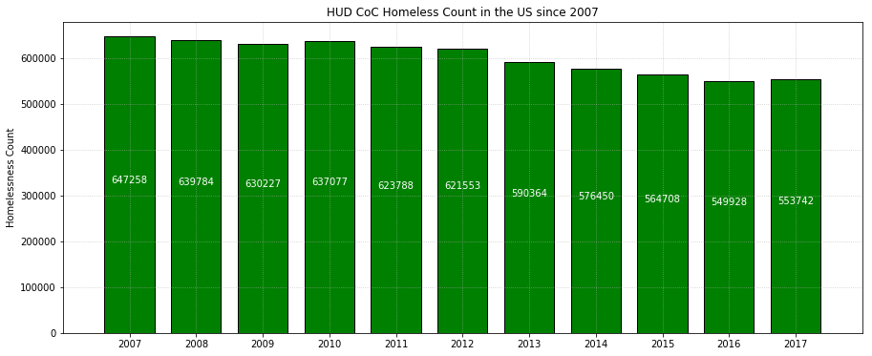
HUD CoC Homeless Count in the US since 2007

Slide 9
Discussion - Cont’d
At what rate has homelessness changed in the past decade?
Homelessness in the U.S. decreased by 14% since 2007, based on HUD’s CoC (Continuum of Care) counts. Why?
One explanation is that there is a great deal of variation in the data in different parts of the country, however, many places continue to see reductions in homelessness. Thirty (30) states and the District of Columbia reported decreases in homelessness between 2016 and 2017. Challenges in some major metropolitan areas, however, have had a major impact on the national trend lines.
At the state level, homeless counts decrease between 2007 and 2017 for almost all states, with the exception of HI, DC, MA, NY.

Slide 10
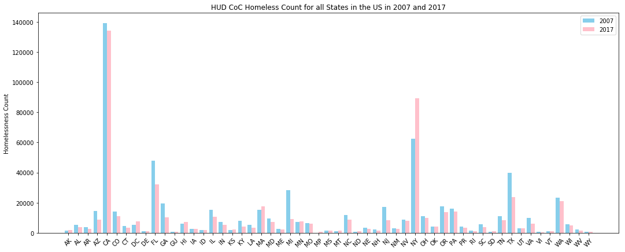
HUD CoC Homeless Count for US States in 2007 and 2017

Slide 11
Discussion
Is there a correlation between homelessness and real estate prices?
A scatterplot of home prices versus homelessness for 18 major cities across the U.S., does not show a clear positive correlation between these two variables. The data does indicate a pocket with high homeless counts, in areas where estimated median home values are between ~400-700K.
A closer look at for four different cities (San Francisco, Los Angeles, New York and Miami) shows a positive correlation between these two variables from 2012 until 2017.
Notes:
Note for discussion- correlation between median home sales and Zillow’s estimated median value (ZHVI) Shows that ZHVI estimates can be used as representative of actual house prices. ZHVI data was available for all cities, so that’s why we used it, instead of actual house prices.

Slide 12
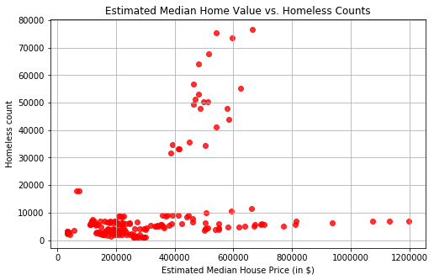
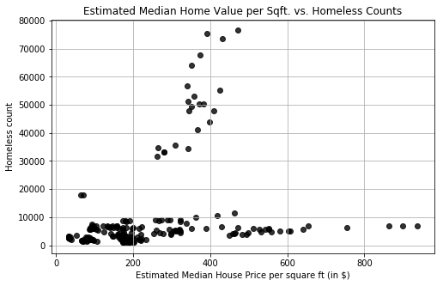
Estimated Median Home Value/Median Home Value per Sqft. vs. Homeless Counts

Slide 13
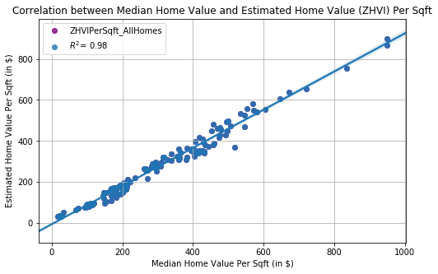
Correlation between Median Home Value and Estimated Home Value (ZHVI) Per Sqft

Slide 14
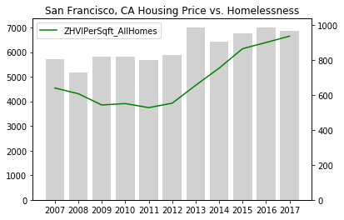
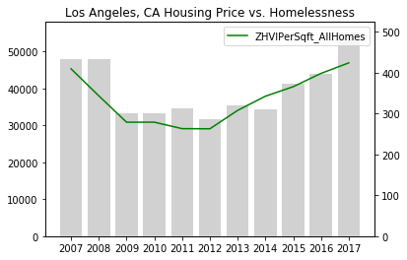
California - San Francisco and Los Angeles

Slide 15
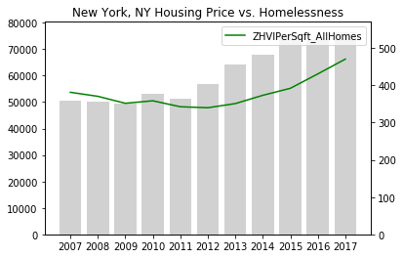
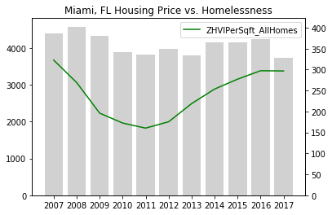
New York City and Miami

Slide 16
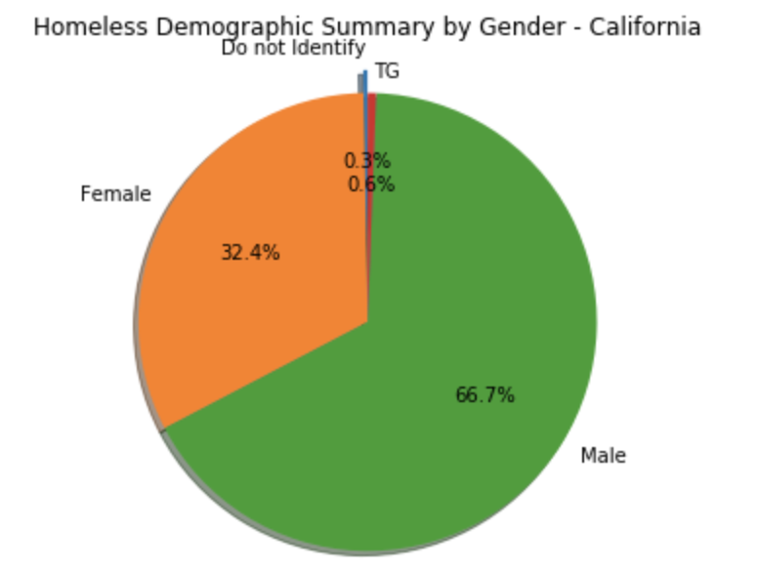
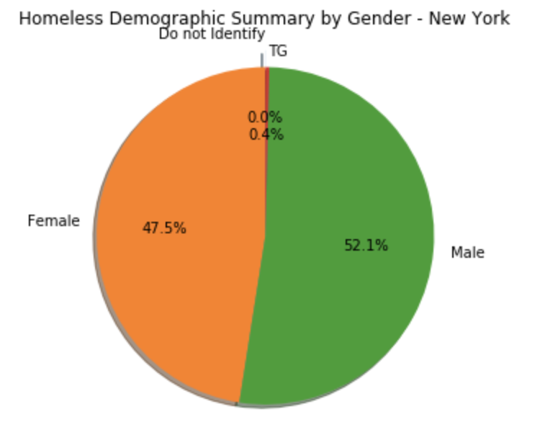
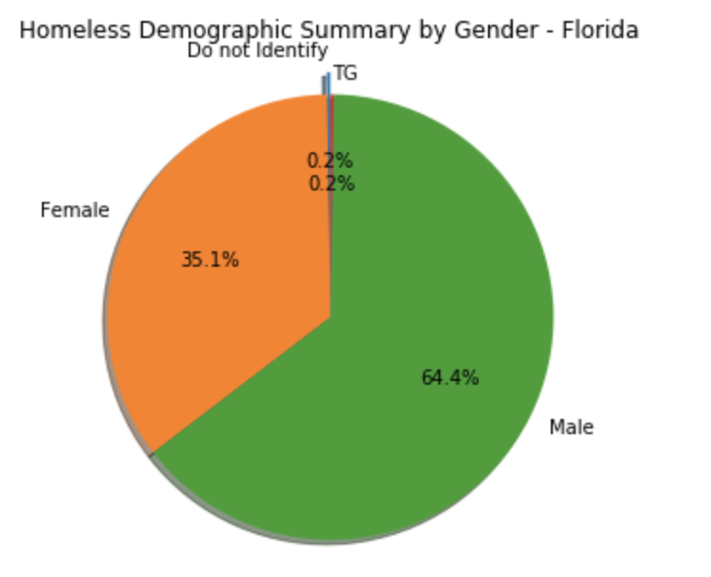
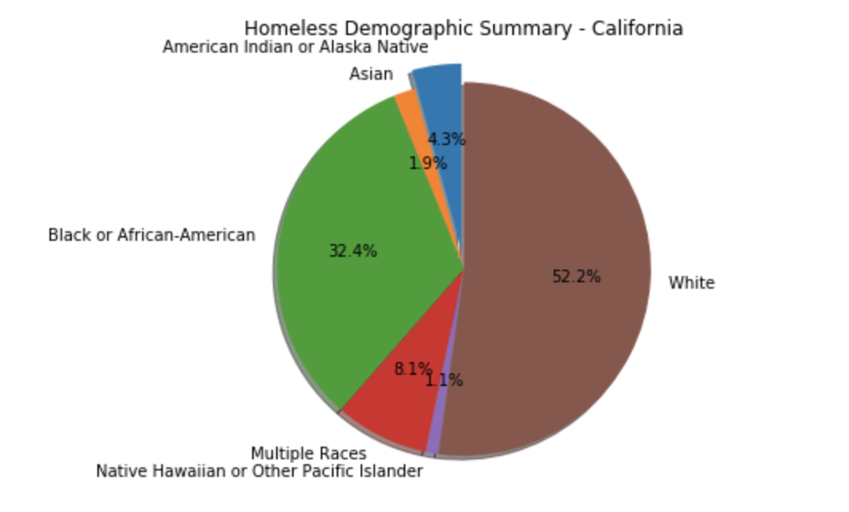
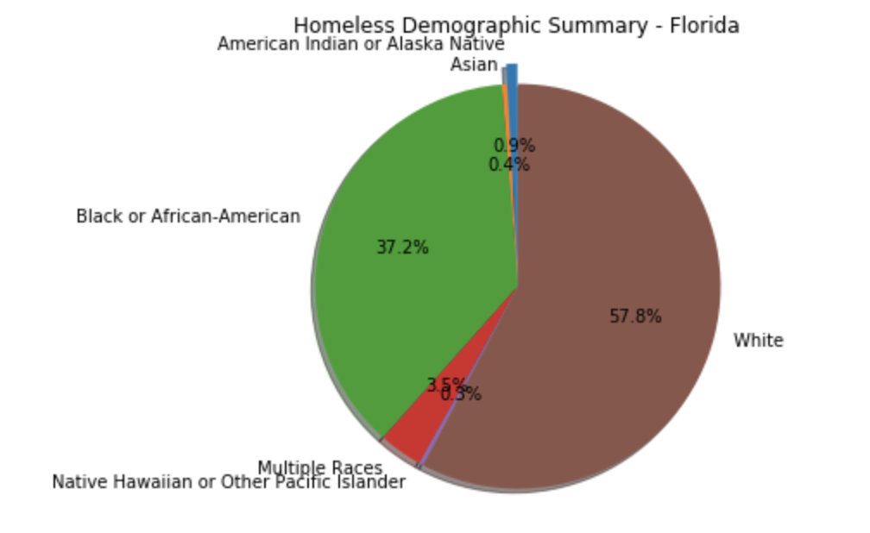
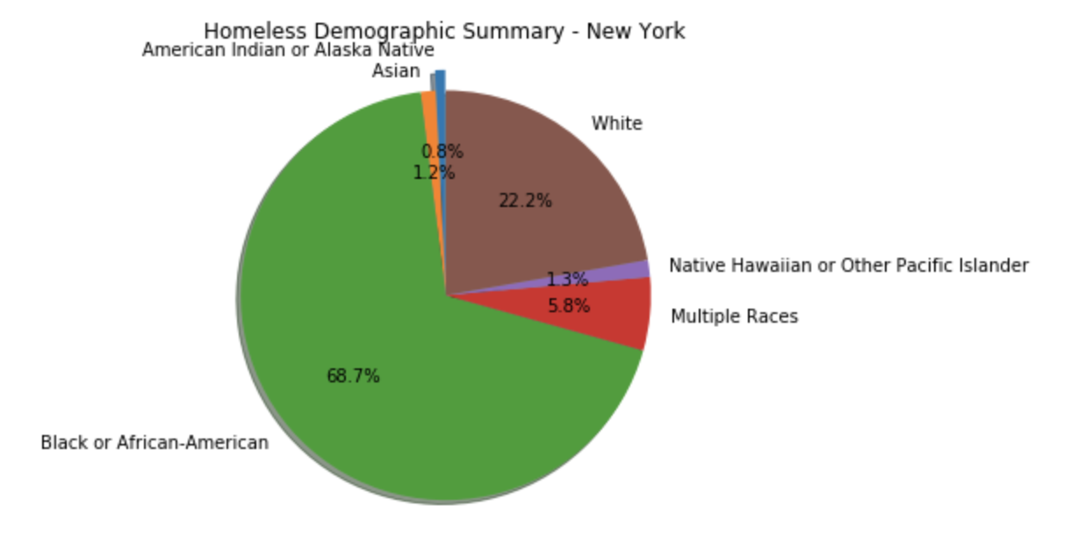
Discussion - Cont’d
What does the homeless population demographics look like?
A snapshot of the homeless population in 2017 for the states with the highest homeless population (CA, FL, NY):
By Gender
New York - almost equal proportion of males and females
California and Florida - ~2:1 male to female ratio
By Race
New York - 69% African American, 22.2% White, 6% multiracial
California - 52% White, 32% African American, 8% multiracial
Florida - 58% White, 37% African American, 4% multiracial

Slide 17
Post Mortem
Other variables that influence homelessness
Population size/infrastructure
Cost of living
Unemployment rate
Other variables that influence homelessness
Population size/infrastructure
Cost of living
Unemployment rate
Social services/shelters/churches/non-profits
Per capita personal income
Bussing (see article Bussed Out in The Guardian)
Education
Climate
Notes:
After all the analyses we had done, we cannot help but think what other factors might affect homeless populations? especially when we found out California had highest homeless counts, it’s just natural to ask if it is because of its large population, and the weather is nice, or maybe the goverment provide better services for the homeless people, say free food? Out of curiosity, i did some further data analysis between homeless counts versus these three factors. And we did get some interesting findings,

Slide 18
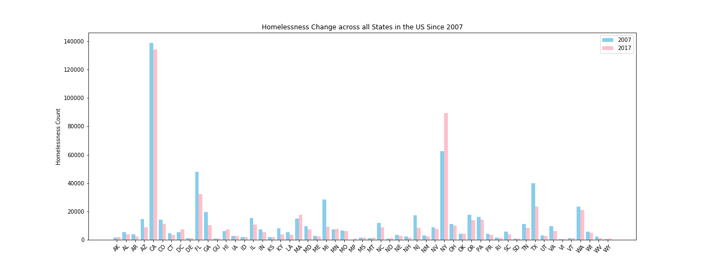
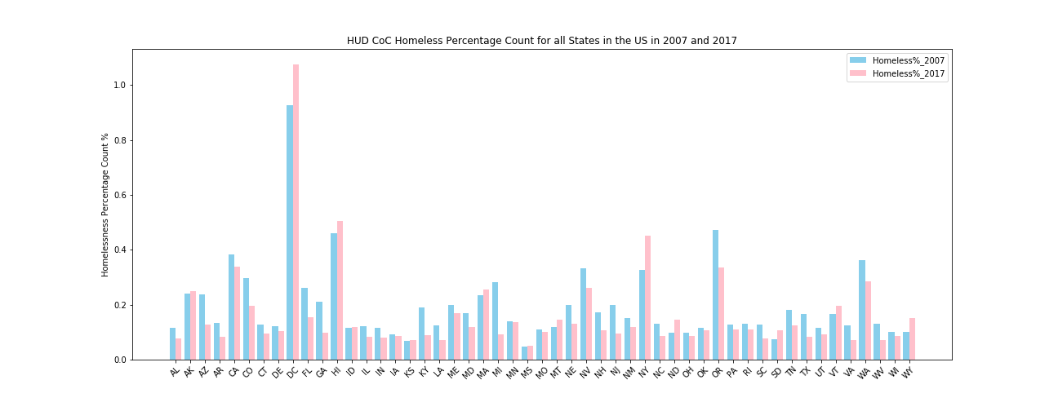
Other Variables
Which state has the highest population density?
Before considering state population: The states of CA, NY, FL, TX and WA are the top 5 states with the highest homeless populations;
After normalization, the top 5 states are: DC, HI, NY, OR, WA, MA
CA
DC

Slide 19
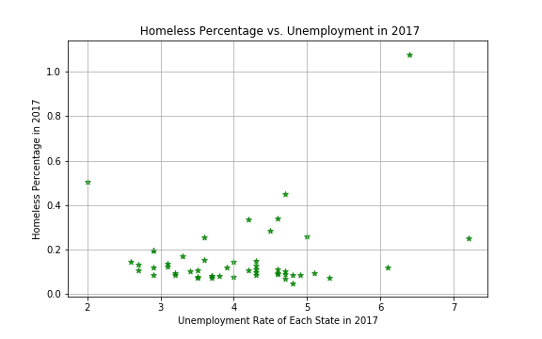
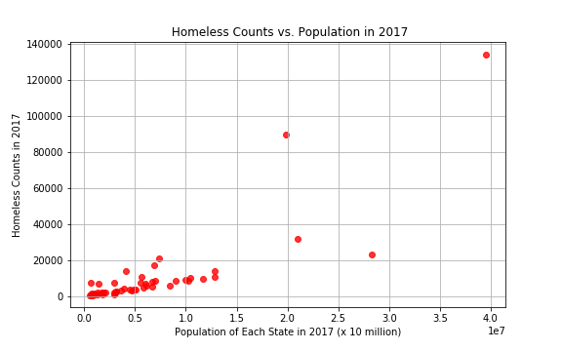
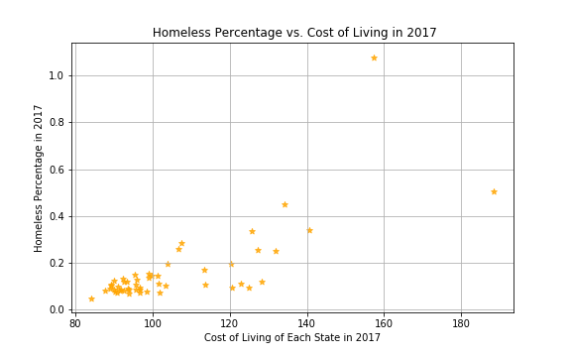
Other Variables - Cont’d
Homeless vs. Population
Homeless percentage vs. Unemployment
Homeless percentage vs. Cost of living
Data Source:
https://www.bls.gov/web/laus/laumstrk.htm
https://www.missourieconomy.org/indicators/cost_of_living/
Data Analysis:
Merge 5 csv files with cleaned-up HUD data based on State -> Plot
Notes:
snapshot of three factors vs homelessness in the year of 2017
https://github.com/jag0717/UCB-Project1/tree/leiguo-data/census_data

Slide 20
Conclusions
National homeless population decreased between 2007 and 2017
Real estate pricing does have some impacts on homelessness condition
Homelessness is highly correlated with population sizes state wise, as well as cost of living in general

Slide 21
References
Bussed Out - How American moves its Homeless (article) . The Guardian. Published online: 20 December 2017 https://www.theguardian.com/us-news/ng-interactive/2017/dec/20/bussed-out-america-moves-homeless-people-country-study
Homelessness in the United States: Trends and demographics (article). Journalist’s Resource. Harvard Kennedy School Shorenstein Center on Media, Politics and Public Policy. Published online: 4 December 2014 https://journalistsresource.org/studies/government/health-care/homelessness-u-s-trends-demographics

Slide 22
Thank You!

